Slide 1
Kubernetes components Master components

Slide 2
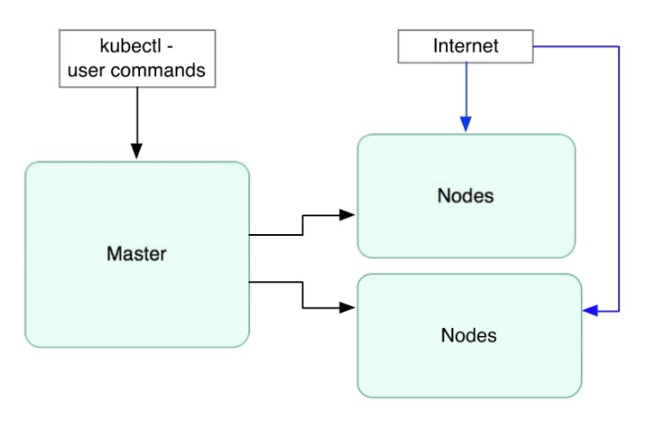
High Level Components
Notes:
Key points:
Kubectl - The kubectl utility lets you interface with the Kubernetes cluster manager.
For example, you can add and delete nodes, pods, replication controllers, and services. You can also check their status, and so on.
Master - The master services are the set of main Kubernetes control services, usually running on one server. If high availability is needed, they can be run on a multiple servers behind a load balancer.
Node - A node (sometimes called a worker node/minion) is a physical or virtual machine running Kubernetes services, onto which pods can be scheduled.
Nodes are managed by the control plane.

Slide 3
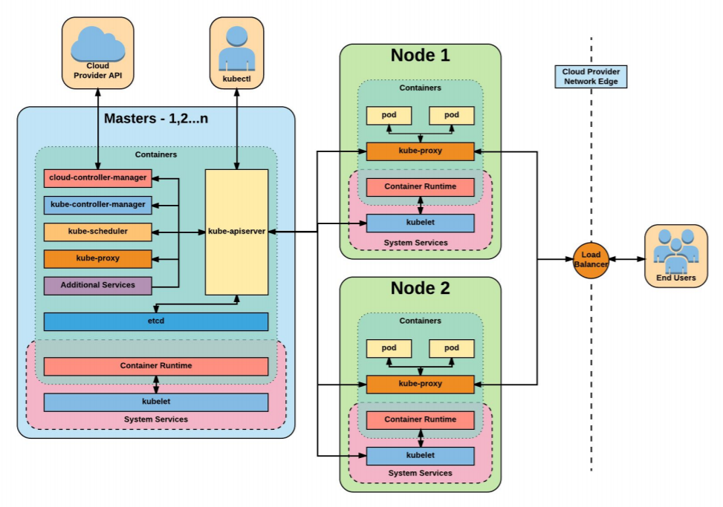
Kubernetes Architecture

Slide 4
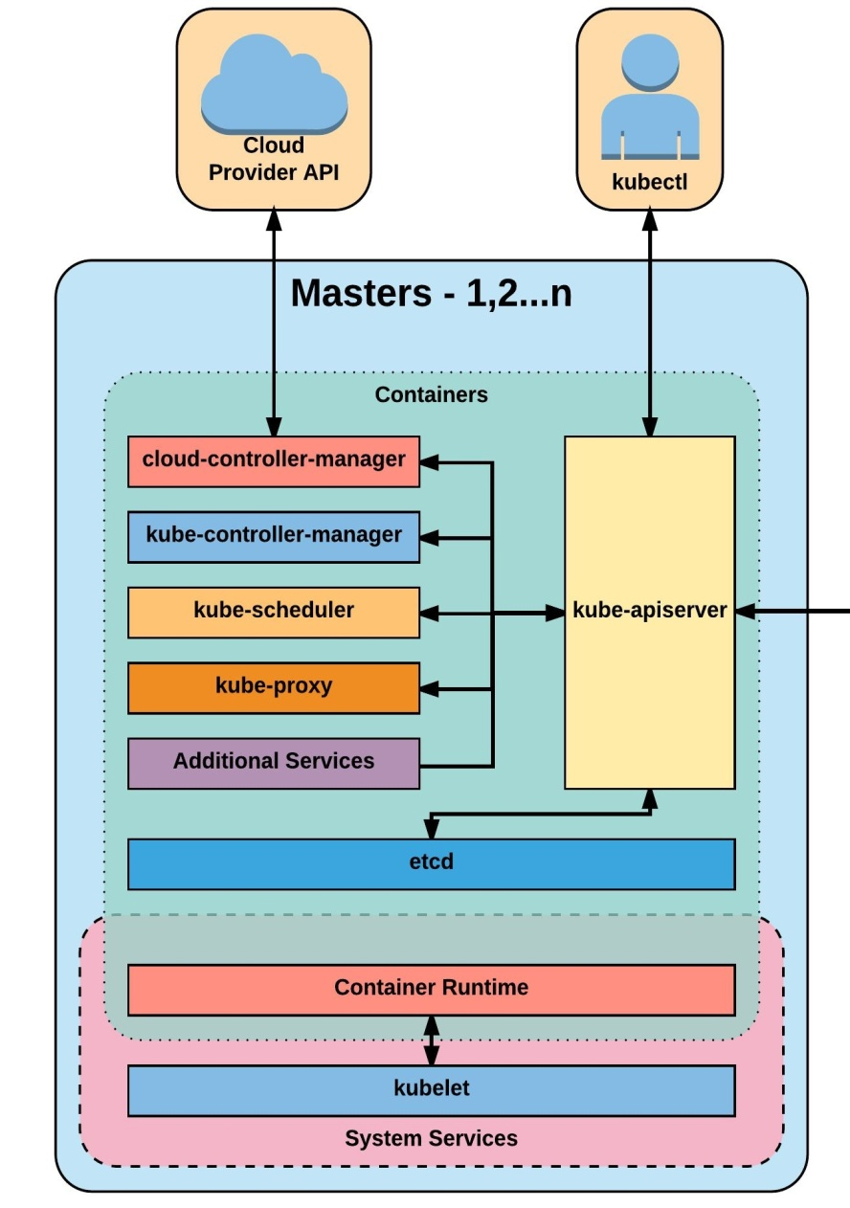
Master Components
Kube-apiserver
Etcd
Kube-controller-manager
Cloud-controller-manager
Kube-scheduler

Slide 5
kube-apiserver
REST interface into the kubernetes control plane and datastore.
All clients, including nodes, users and other applications interact with kubernetes strictly through the API Server.
Acting as the gatekeeper to the cluster by handling:
Authentication and authorization
Request validation
Mutation, and admission control

Slide 6
etcd
Etcd acts as the cluster datastore
Provides a strong, consistent and highly available key-value store used for persisting cluster state.

Slide 7
cloud-controller-manager
Provides cloud-provider specific knowledge and integration capability into the core control loop of Kubernetes.

Slide 8
kube-controller-manager
Primary daemon that manages all core component control loops
Monitors the cluster state via the apiserver and steers the cluster towards the desired state
List of core controllers:
https://github.com/kubernetes/kubernetes/blob/master/cmd/kube-controller-manager/app/controllermanager.go#L332

Slide 9
kube-scheduler
Evaluates workload requirements and attempts to place it on a matching resource.
These requirements can include:
Hardware requirements
Affinity/Anti-affinity
other custom resource requirements.

Slide 10
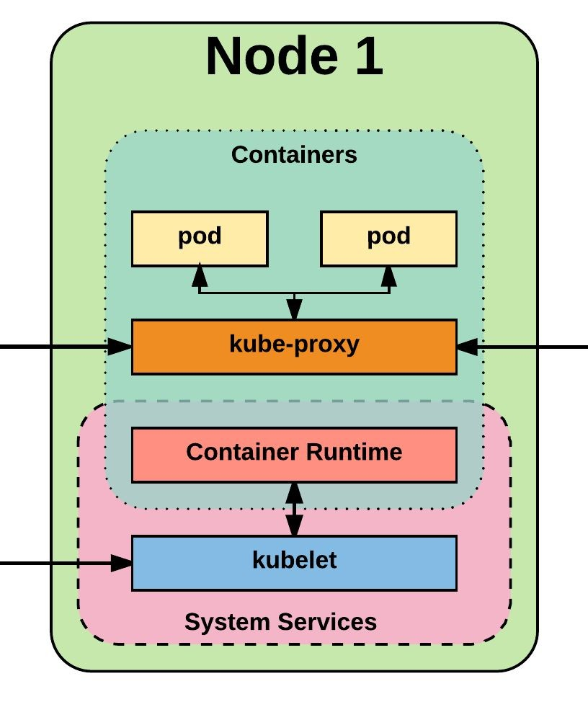
Node Components
Kubelet
Kube-proxy
Container runtime engine

Slide 11
kubelet
Acts as the node agent responsible for managing pod lifecycle on its host.
Kubelet understands YAML/JSON container manifests that it can read from several sources:
File path
HTTP Endpoint
Etcd watch acting on any changes
HTTP Server mode accepting container manifests over a simple API

Slide 12
kube-proxy
Manages the network rules on each node and performs connection forwarding or load balancing for Kubernetes cluster services.
Available proxy modes:
Userspaces
Iptables
ipvs (alpha in 1.8)
https://kubernetes.io/docs/concepts/services-networking/service/#virtual-ips-and-service-proxies

Slide 13
Container Runtime
With respect to Kubernetes, a container runtime is a CRI (Container Runtime Interface) compatible application that executes and manages containers.
Containerd (Docker)
Cri-o
Rkt
Kata (formerly clear and hyper)
Virtlet (VM CRI compatible runtime)

Slide 14



What is a POD?
Labels
Group of Containers
Live and die together
Share:
IP
Secrets
Labels*
Volumes*
IP: 10.x.x.x
Application
Administrative Console
Volume
Log Collector
Notes:
Key Points:
Pods are a collocated group of application containers with shared volumes.
Pods are the smallest deployable units that can be created, scheduled, and managed with Kubernetes. Pods can be created individually.
As pods do not have a managed lifecycle, if they die, they will not be recreated. For that reason, it is recommended that you use a replication controller (which we cover later) even if you are creating a single pod.

Slide 15
Pod Examples
ELK Stack
WordPress + MySQL
Nginx + Logstash
Auth + Proxy + PHP
App + data-load

Slide 16

Pods - How it looks?
IPC
Network
PID
Hostname
cgroup
cgroup
File Puller
localhost
Web Server

Slide 17
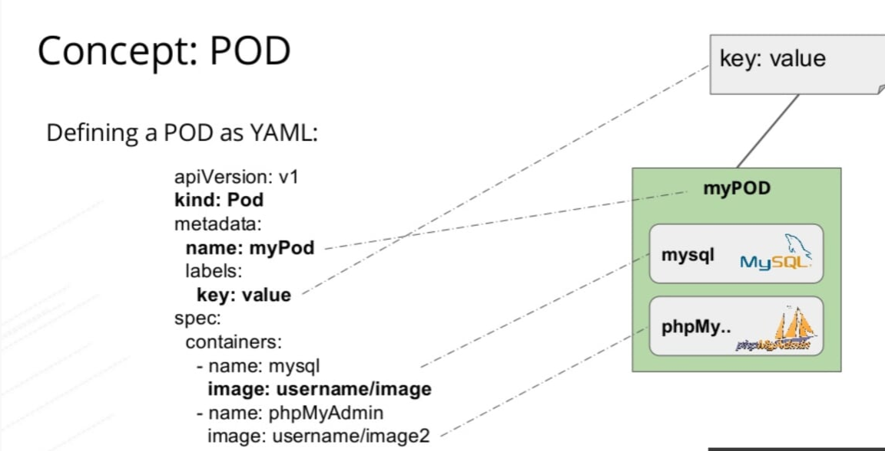
Pods Example
Notes:
Key Points:
In this yaml file :
Name - is the name you give to your container
image - is the Docker image name you want to use
containerPort - exposes the specified container port so we can connect to the nginx server at the pod’s IP address

Slide 18
